Slide 1

Investigation into Using Motor Activity from Wearable Devices as well as Computerised Tests to Build Binary Classification Models to Predict ADHD.

Slide 2
Contents
Project Background
Aims of the Study
Methodology
Results

Slide 3
Background
What is ADHD?
- Neurological Condition
- Symptoms
- Inattentiveness
- Hyperactivity/Impulsiveness
- Combined
- Estimated to affect approx. 8% of adults
- Associated with many comorbidities

Slide 4
Why?
Diagnosis is done through semi-structured interviews with professional Clinicians
Objective tests to aid and improve this are desirable
Understanding predictors could refine understanding of ADHD
Most ML research has focused on children and only classified as people with ADHD or Healthy
Lack of availability of Public Datasets to reproduce results

Slide 5
Aims of the Study
Phase 1: Reproduce findings presented in Hyperaktiv study
Phase 2: Use Motor Activity Data for Binary Classification of ADHD
Phase 3: Use data from Computerised Testing to produce a Binary Classification of ADHD and analyse the results for insights

Slide 6
Hyperaktiv Dataset
Dataset (103 participants)
Motor Activity (85 participants)
Timeseries of motor activity for each participant
Patient Information
Age, Sex, Comorbidities, medication, diagnostics
Conner’s Continuous Progression Test (CPT-II) (99 participants)
Standardised test of sustained concentration
Computerised and numerical
Heart Rate Data

Slide 7
Cohorts
ADHD
Non-ADHD
Healthy Controls
Hyperaktiv Dataset
Psykose/Depresjon datasets

Slide 8
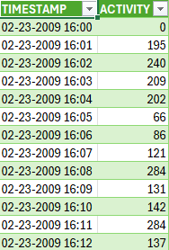
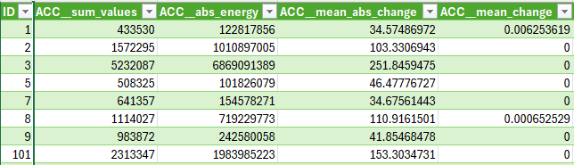
Data Preprocessing Phase 1
Motor Activity Data
tsfresh
788 Timeseries Features

Slide 9
Phase 1: Reproduction of Baseline in Hyperaktiv Study
Code and features were provided and comparable performance metrics were obtained
Issues with Feature Selection
Feature selection was performed on the dataset before the test/train split
With high dimensionality, high risk of overly optimistic results

Slide 10
Phase 1: Reproduction of Baseline in Hyperaktiv Study
Issues with Data Leakage
52 features were selected
Average length of timeseries approx. double in Healthy cohort
Slightly higher in non-ADHD cohort
All but one of the selected features were related to length of timeseries
first location of the minimum value as a fraction of the total number of points
0 for all Hyperaktiv dataset
7 healthy controls were non-zero

Slide 11
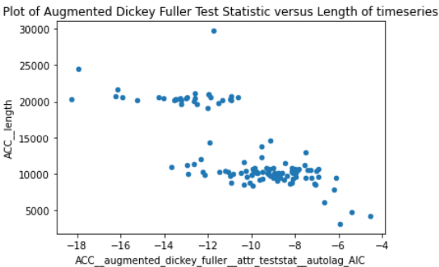
Phase 1: Reproduction of Baseline in Hyperaktiv Study

Slide 12
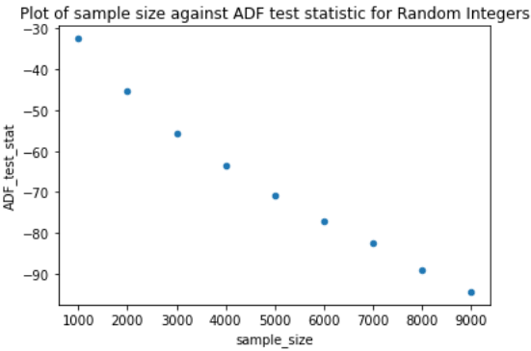
Phase 1: Reproduction of Baseline in Hyperaktiv Study

Slide 13
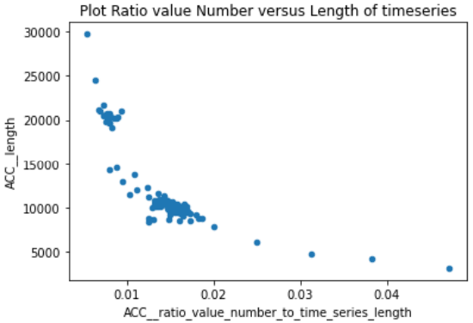
Phase 1: Reproduction of Baseline in Hyperaktiv Study
number of unique values as a fraction of the total values

Slide 14
Phase 2: Use Motor Activity Data for Binary Classification of ADHD
Healthy Cohort Dropped

Slide 15
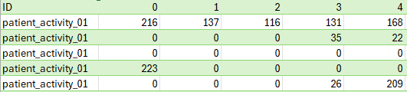
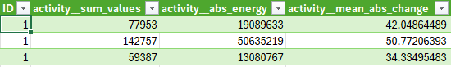
Data Preprocessing Phase 2
Motor activity
for each
complete day
Tsfresh features
for participant
Raw Data for participant

Slide 16
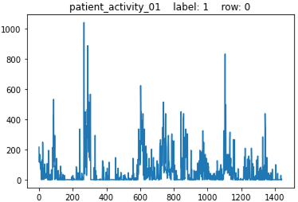

Phase 2: Use Motor Activity Data for Binary Classification of ADHD

Slide 17
Phase 2: Use of Motor Activity Data for Binary Classification of ADHD
Modelling
Leave-One-Group-Out Cross Validation
Random Forest Classifier
High dimensionality
Regularisation
Aggregation of results by participant

Slide 18
Phase 2: Use Motor Activity Data for Binary Classification of ADHD
Challenges and Solutions
High Dimensionality
Max_feature, max_samples, ccp_alpha
Multiple rows belonging to same participant in the training data
Max_samples
Small number of participants
Bootstrapping

Slide 19
Phase 2: Use Motor Activity Data for Binary Classification of ADHD
Investigation into Model Performance
Univariate analysis showed no promising predictors
Projecting the features down to 31 columns, containing 99.9999% of variance, using PCA did not help

Slide 20
Phase 3: Use data from Computerised Testing For Binary Classification of ADHD
8 CPT-II Features selected by boxplots

Slide 21
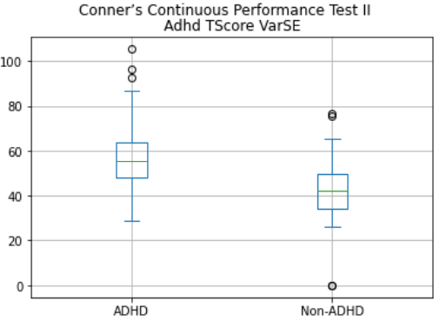
Phase 3: Use data from Computerised Testing For Binary Classification of ADHD

Slide 22
Phase 3: Use data from Computerised Testing For Binary Classification of ADHD
Modelling
Leave-One-Out Cross Validation
Results
Accuracy: 74.75% (data is very balanced)
Precision: 74.5%
Recall: 76%

Slide 23
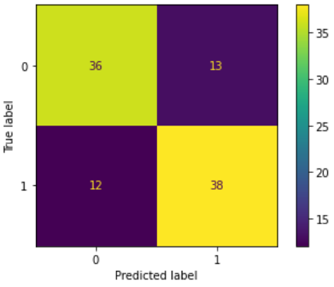
Phase 3: Use data from Computerised Testing to produce a Binary Classification of ADHD and analyse the results for insights

Slide 24
Phase 3: Use data from Computerised Testing For Binary Classification of ADHD
Insights
Strong False Positives
All 4 suffered from an anxiety disorder
3 out of the 4 suffered from bipolar disorder
none had unipolar depression
Strong False Negatives
All 4 had inattentive presentation
None had substance abuse issues
Weak Probailities
No real pattern detected

Slide 25
Future Work
More rigorous modelling on CPT-II data
More models
More sophisticated feature selection
Hyperparameter tuning
Investigate motor activity on cohorts that are not predicted by CPT-II
Understanding Features
More precise feature engineering

